Slide 1
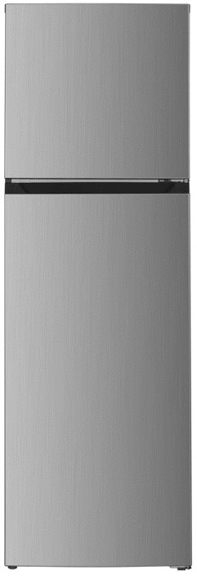
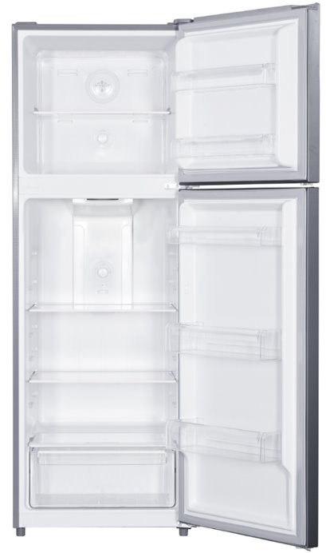
Inverter Compressor Refrigerator 變頻式壓縮機雪櫃
獨特多層送風設計．均勻製冷 Multi Air-flow design 多層送風設計令冷風吹送至每一角落，提高冷凍速度令食`物保持冷凍保鮮效果 Multi Air-flow design speedy deliver cool air in every corner , keep food frozen with fresh. 電子控溫及除霜 Electronic temperature control and Defrost 採用電子控溫及除霜技術，產品性能更穩定 Stabilize performance with accurate temperature control and defrost technology.
3年全機 + 7年壓縮機保用 3 years warranty + 7 years compressor warranty 採用先進技術及優質用料，令性能卓越耐用可靠。長達7年壓縮機保用期，為顧客提供最周全的保障
With advance technology and building structure, perform excellent and robust quality. 7 years compressor warranty provides maximum protect coverage.
1 級能源效益
Grade 1
Energy Efficiency Label
Specifications | PFTM43SV
Total Net Capacity (L) 淨容量 (公升) | 333
Net Freezer Capacity (L) 淨冷凍室 (公升) | 77
Net Refrigerator Capacity (L) 淨冷藏室 (公升) | 256
Freezing Star Rating 冷凍級數 | 4
Environmental Friendly Refrigerant 環保雪種 | R600a
Cooling System 冷凍系統 | Frost Free 無霜
Rated Power 額定功率 | 140W
Multi-purpose door bins 多用途門架 | ü
Ice Tray 冰格 | ü
Egg Tray 蛋架 | ü
Adjustable Shelves 活動式層架 | 3
Vegetable Crisper 蔬果保鮮室 | ü
Recess Handles 隠蔽式把手 | ü
Reversible Doors可轉改開門方向 | ü
Color 顏色 | Silver Grey 銀灰色
Dimensions (HxWxD) mm | 1700x600x665
規格可能因產品改良而作出修改，恕不另行通知。
Specifications may change due to product improvement. No prior notice will be given.

